Slide 1
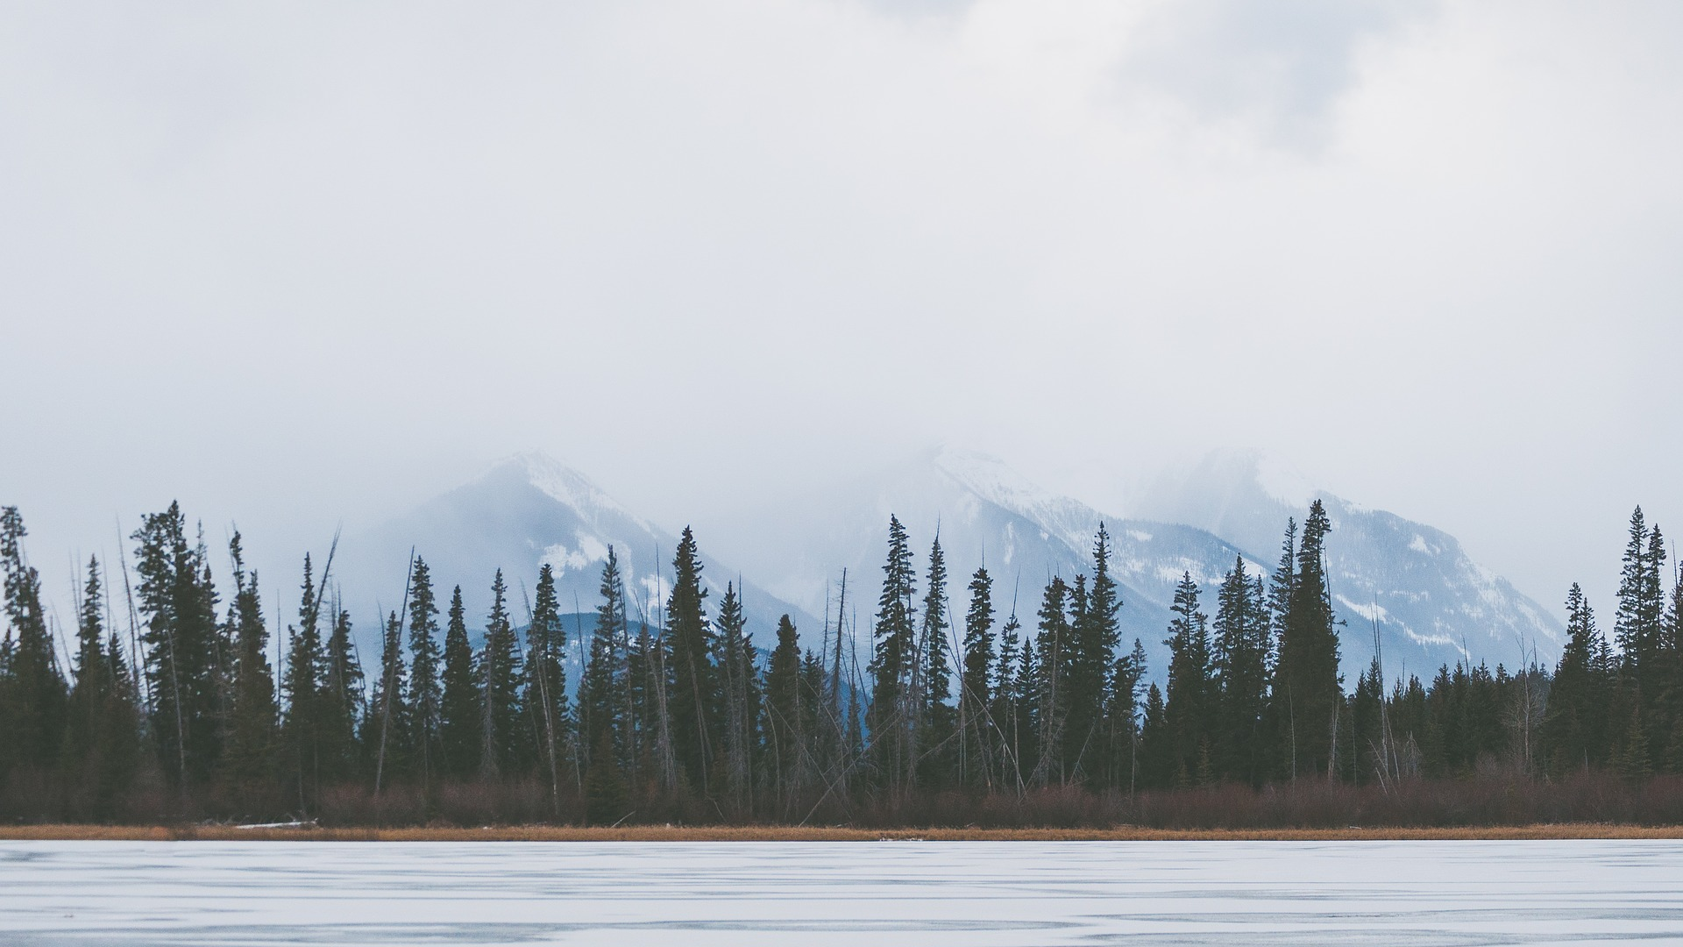

Face Recognition
Shijie Song, Ding Liang, Lu Zhang

Slide 2

01 / Problem & Motivation
02 / Dataset & Data pretreatment
CONTENTS
03 / Algorithms
04 / Conclusion & Questions

Slide 3


1PART
Problem
Motivation
Face recognition has become a popular topic of research recently due to increases in demand for security as well as the rapid development of mobile devices.
The reason why we chose face recognition as our project
In this project, we will propos a facial recognition system that can distinguish a unique face among a collection of faces.

Slide 4
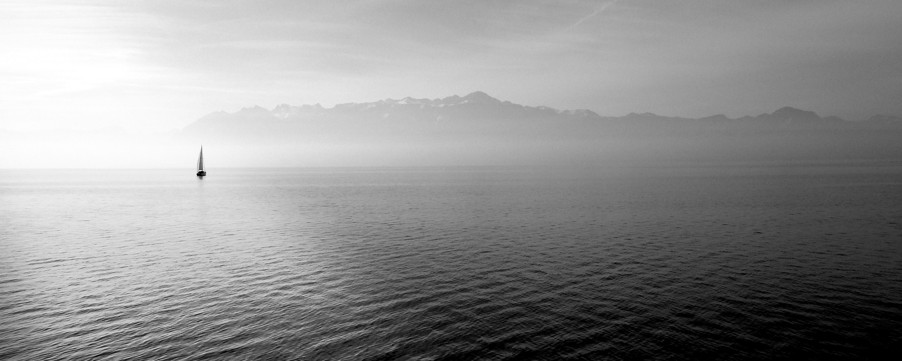

2PART
Dataset
&
Treatment
CACD Faces:
Modified with
Viola-Jones Algorithms
AT&T Faces:
No need to modify

Slide 5
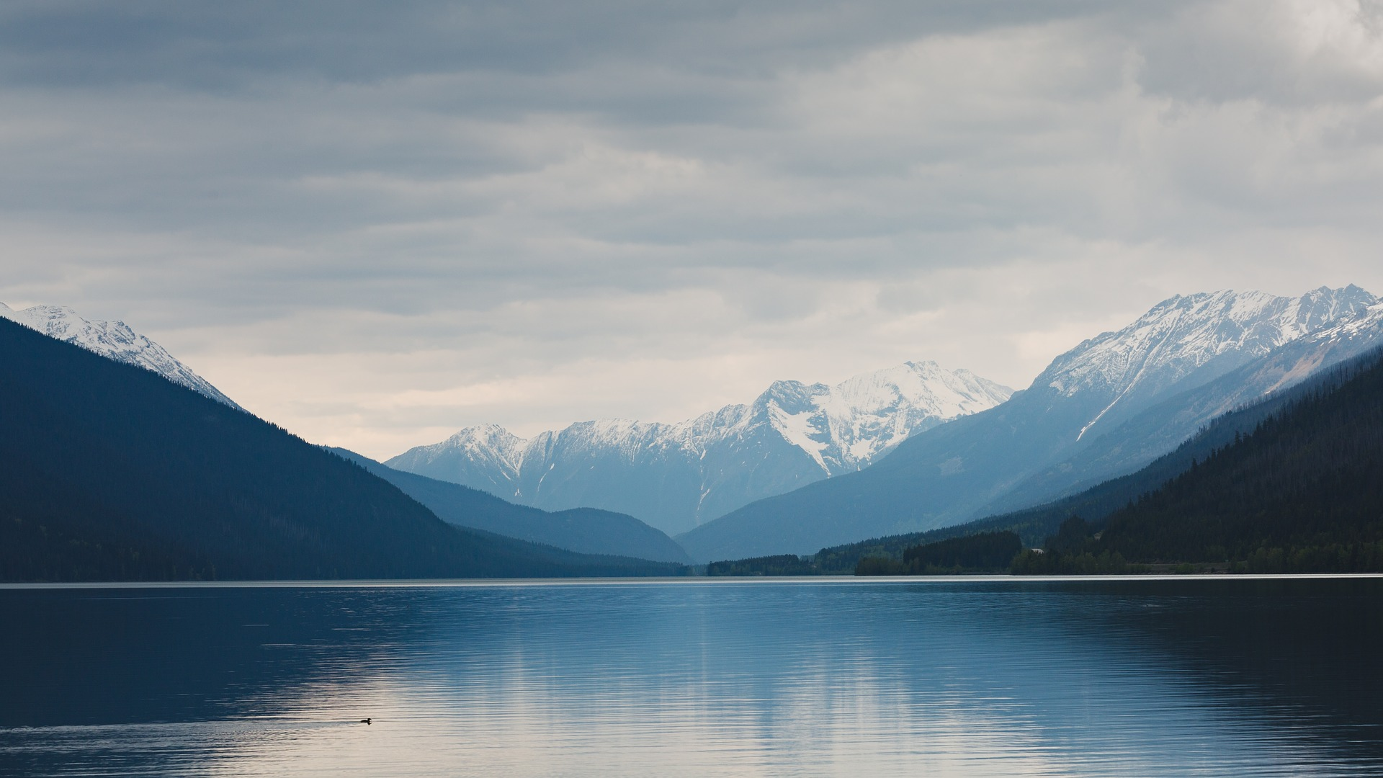
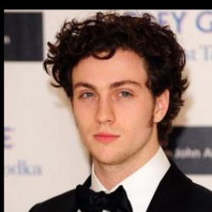
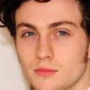


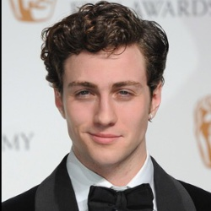
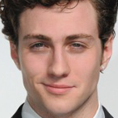
2PART
V&J
V&J
V&J

Slide 6
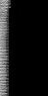
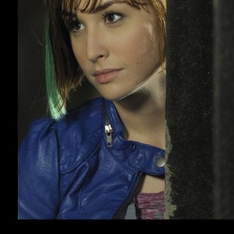
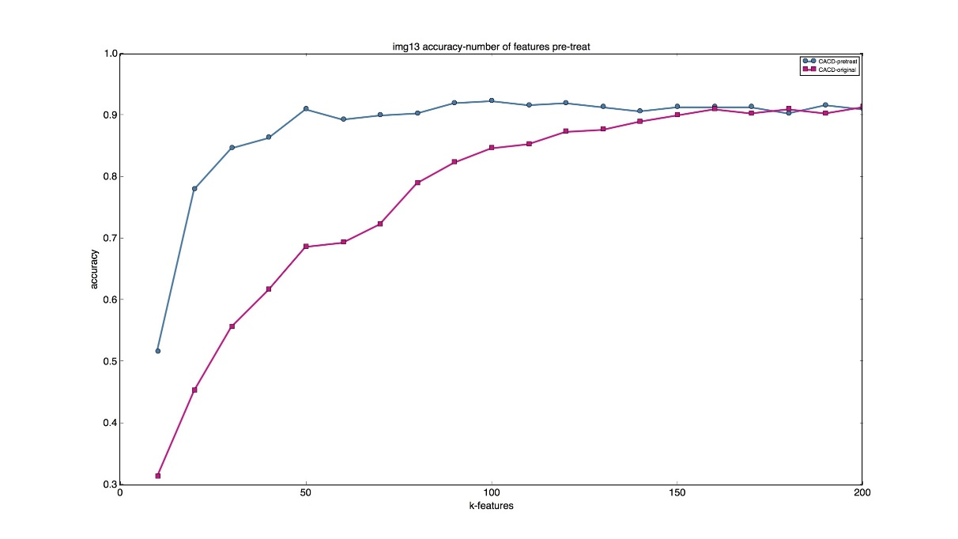
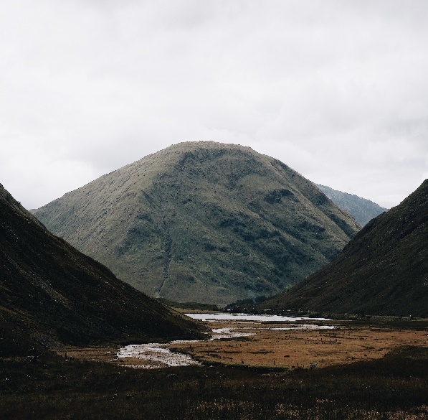
2PART
Detect
Gray
Crop
Clean
PCA-Matrix
Scaled
Pre-Treat

Slide 7


3PART
Algorithms
KNN
SVM
CNN
K-Nearest Neighbor algorithm that is used for classification.
supervised learning models with associated learning algorithms that analyze data used for classification and regression analysis.
a class of deep, feed-forward artificial neural networks that has successfully been applied to analyzing visual imagery.

Slide 8

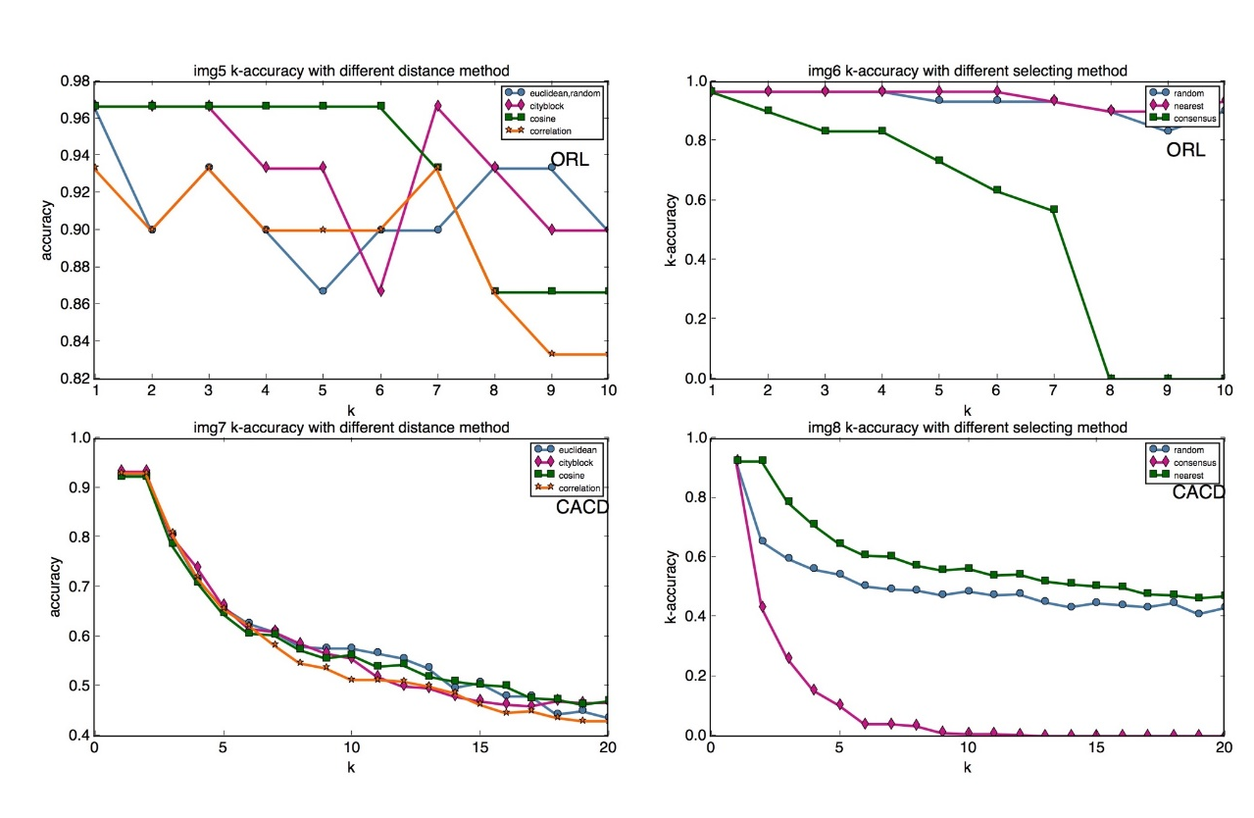
3PART
KNN Algorithm
k Nearest Neighbor algorithm is a very basic common approach for implementing the recommendation system.
In k Nearest Neighbors, we try to find the most similar k number of users as nearest neighbors to a given user, and predict ratings of the user for a given movie according to the information of the selected neighbors.
Class = knnclassify(Testing, Training, class, k, distance, rule)

Slide 9

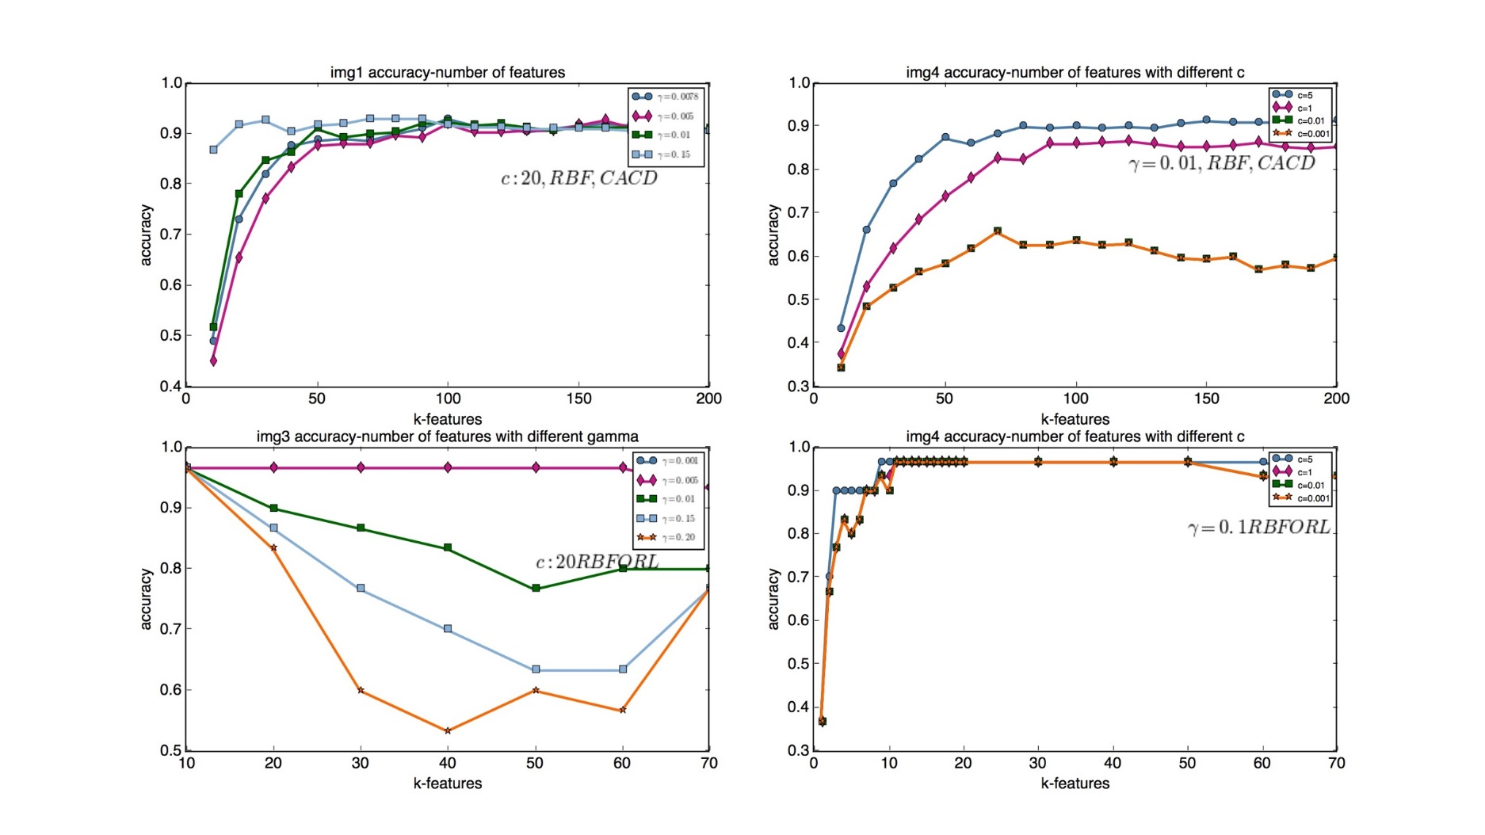
3PART
SVM
Kernal function : RBF
Parameters : Gamma C
More features means more noise, especially in the ORL dataset

Slide 10
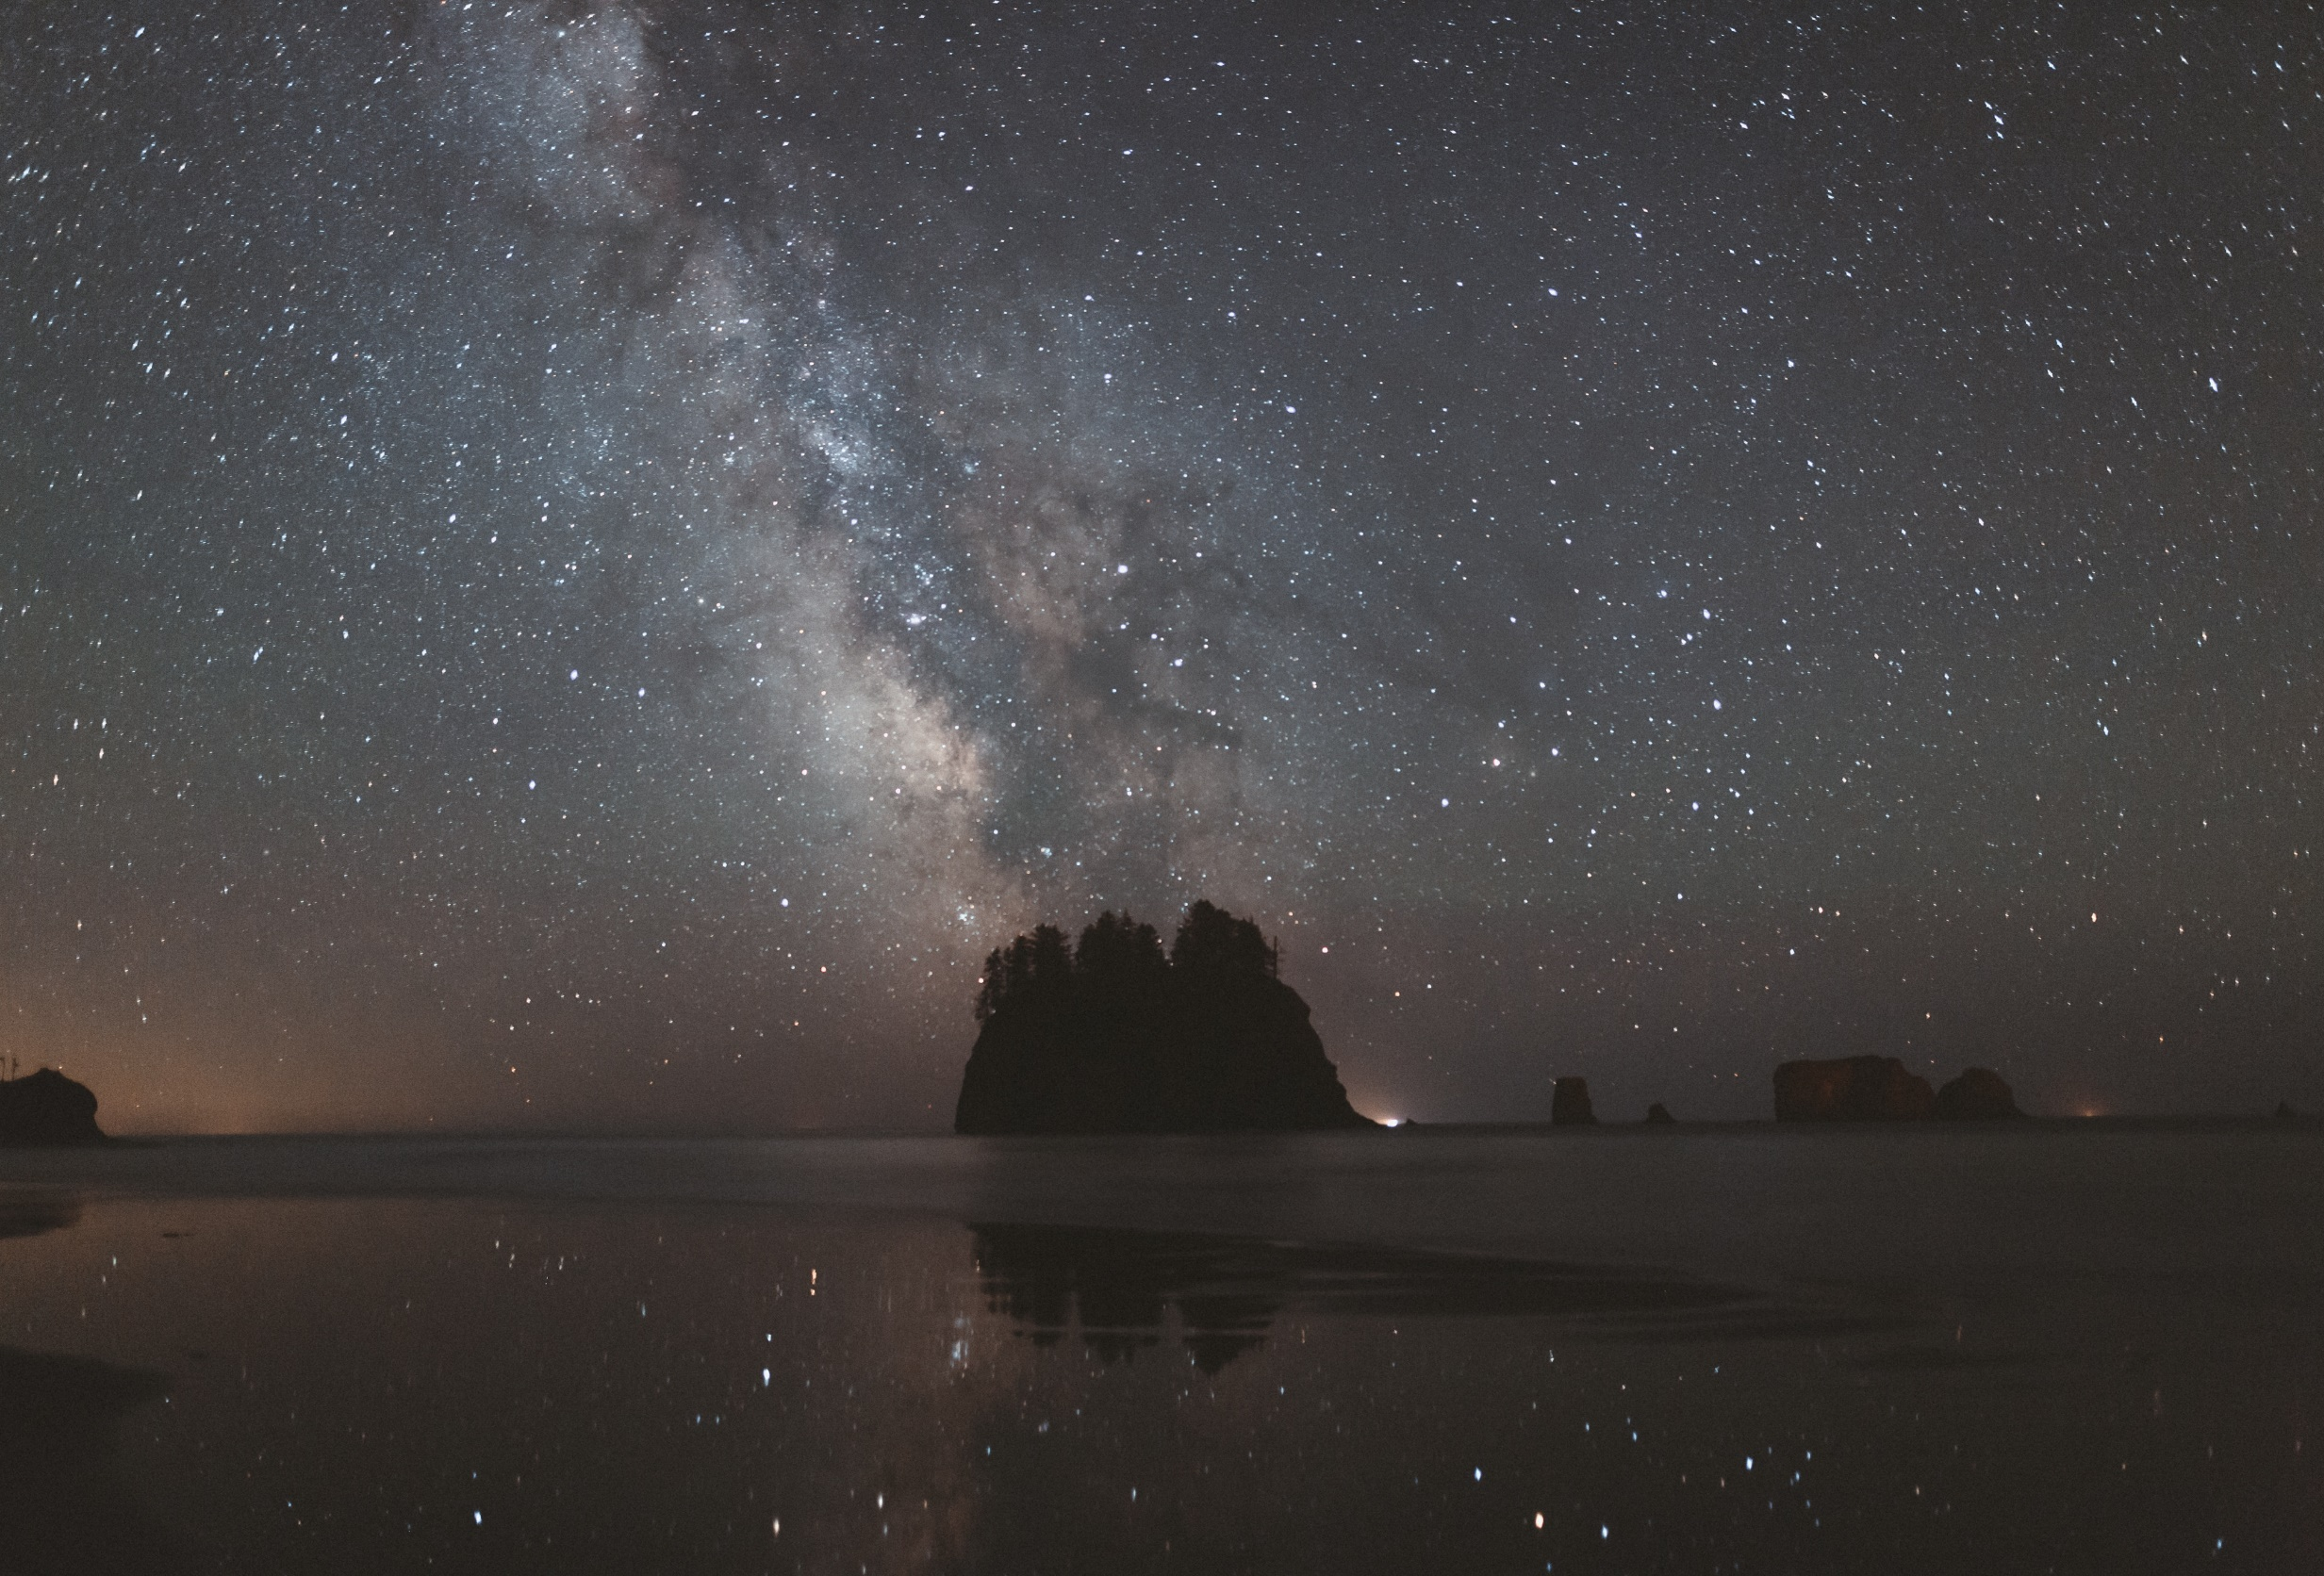
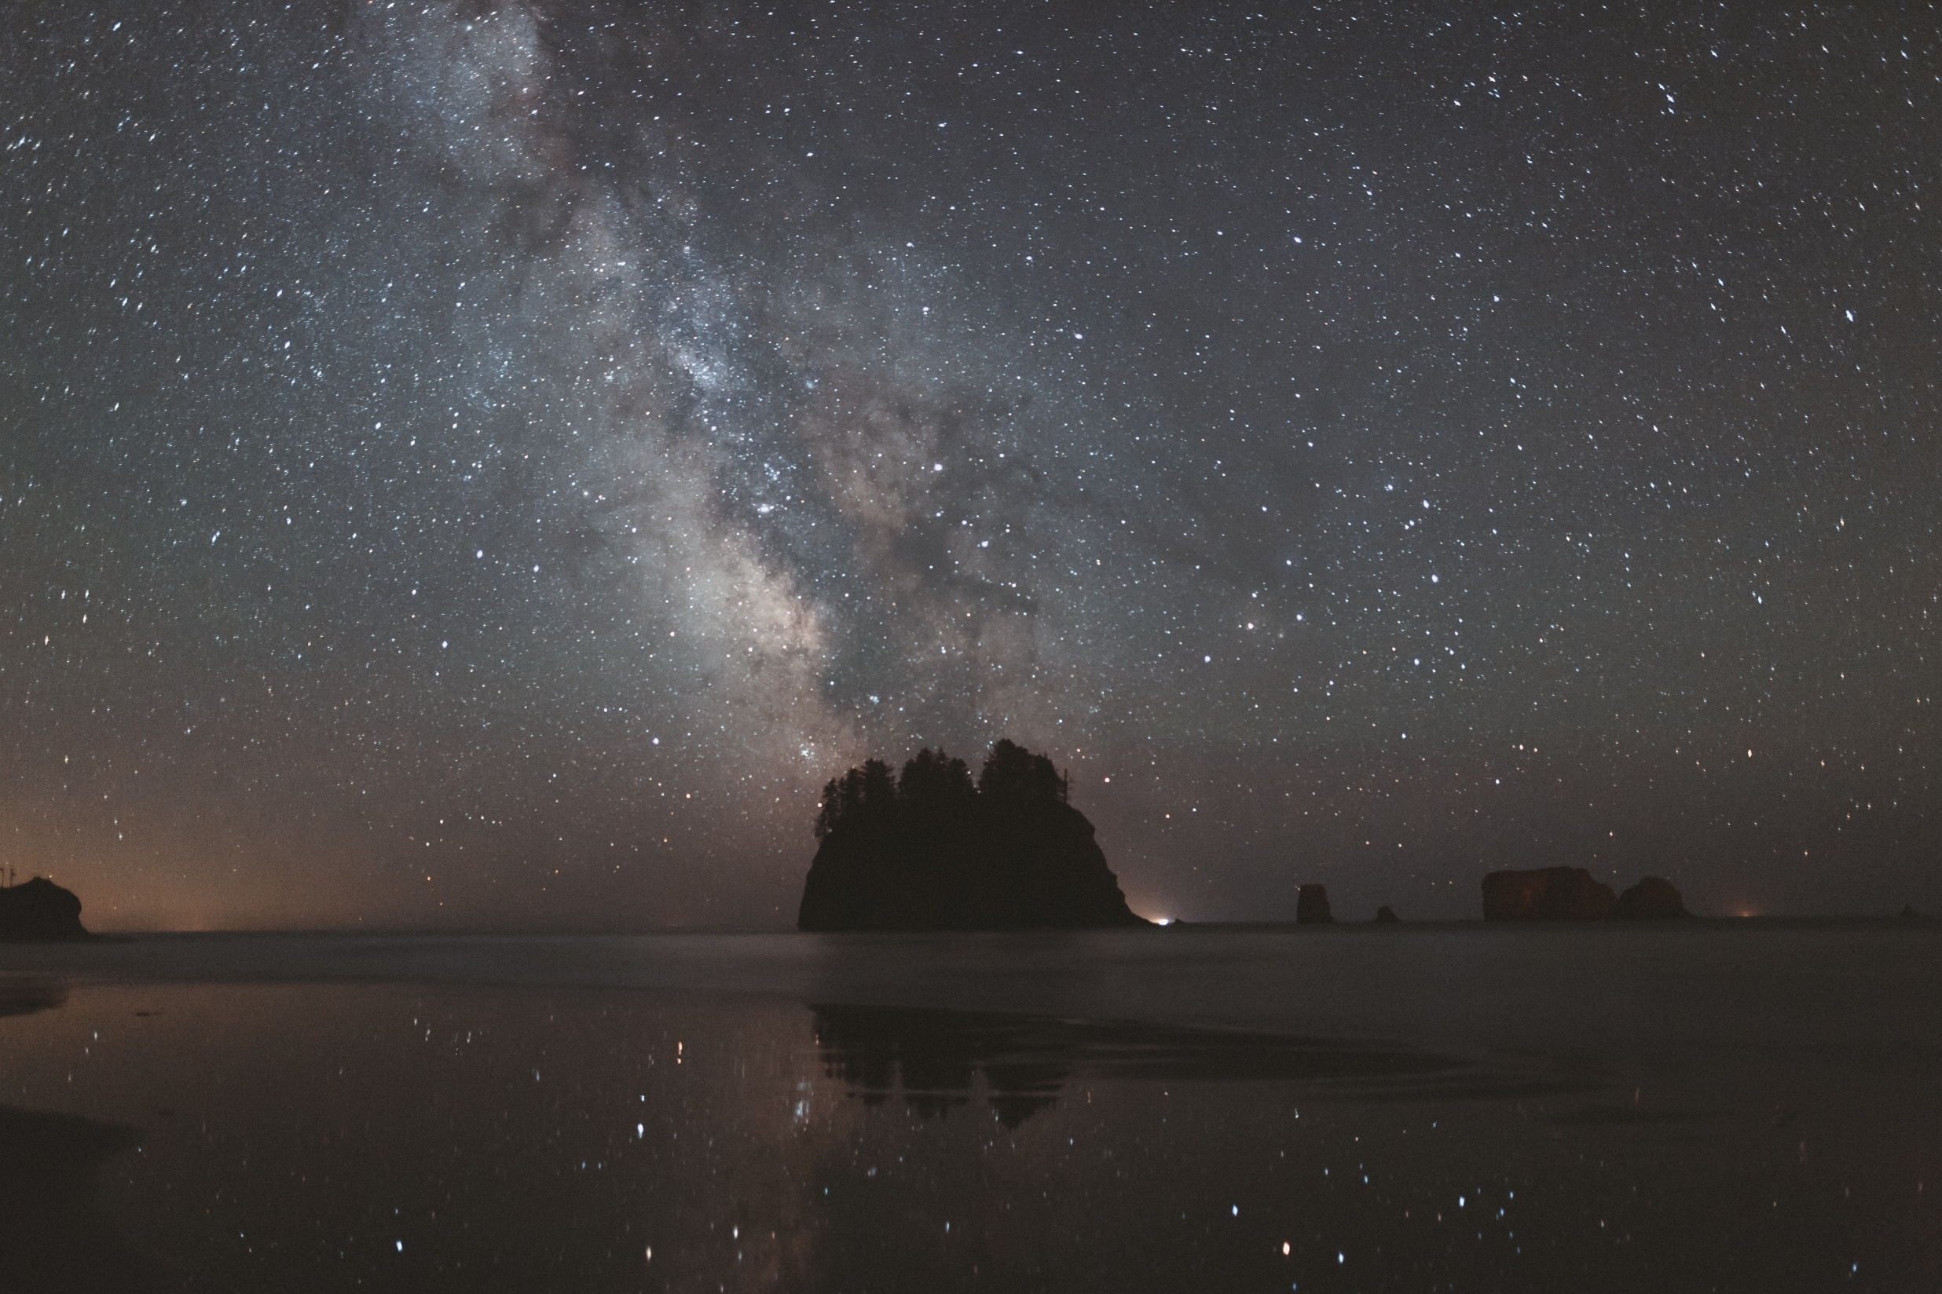
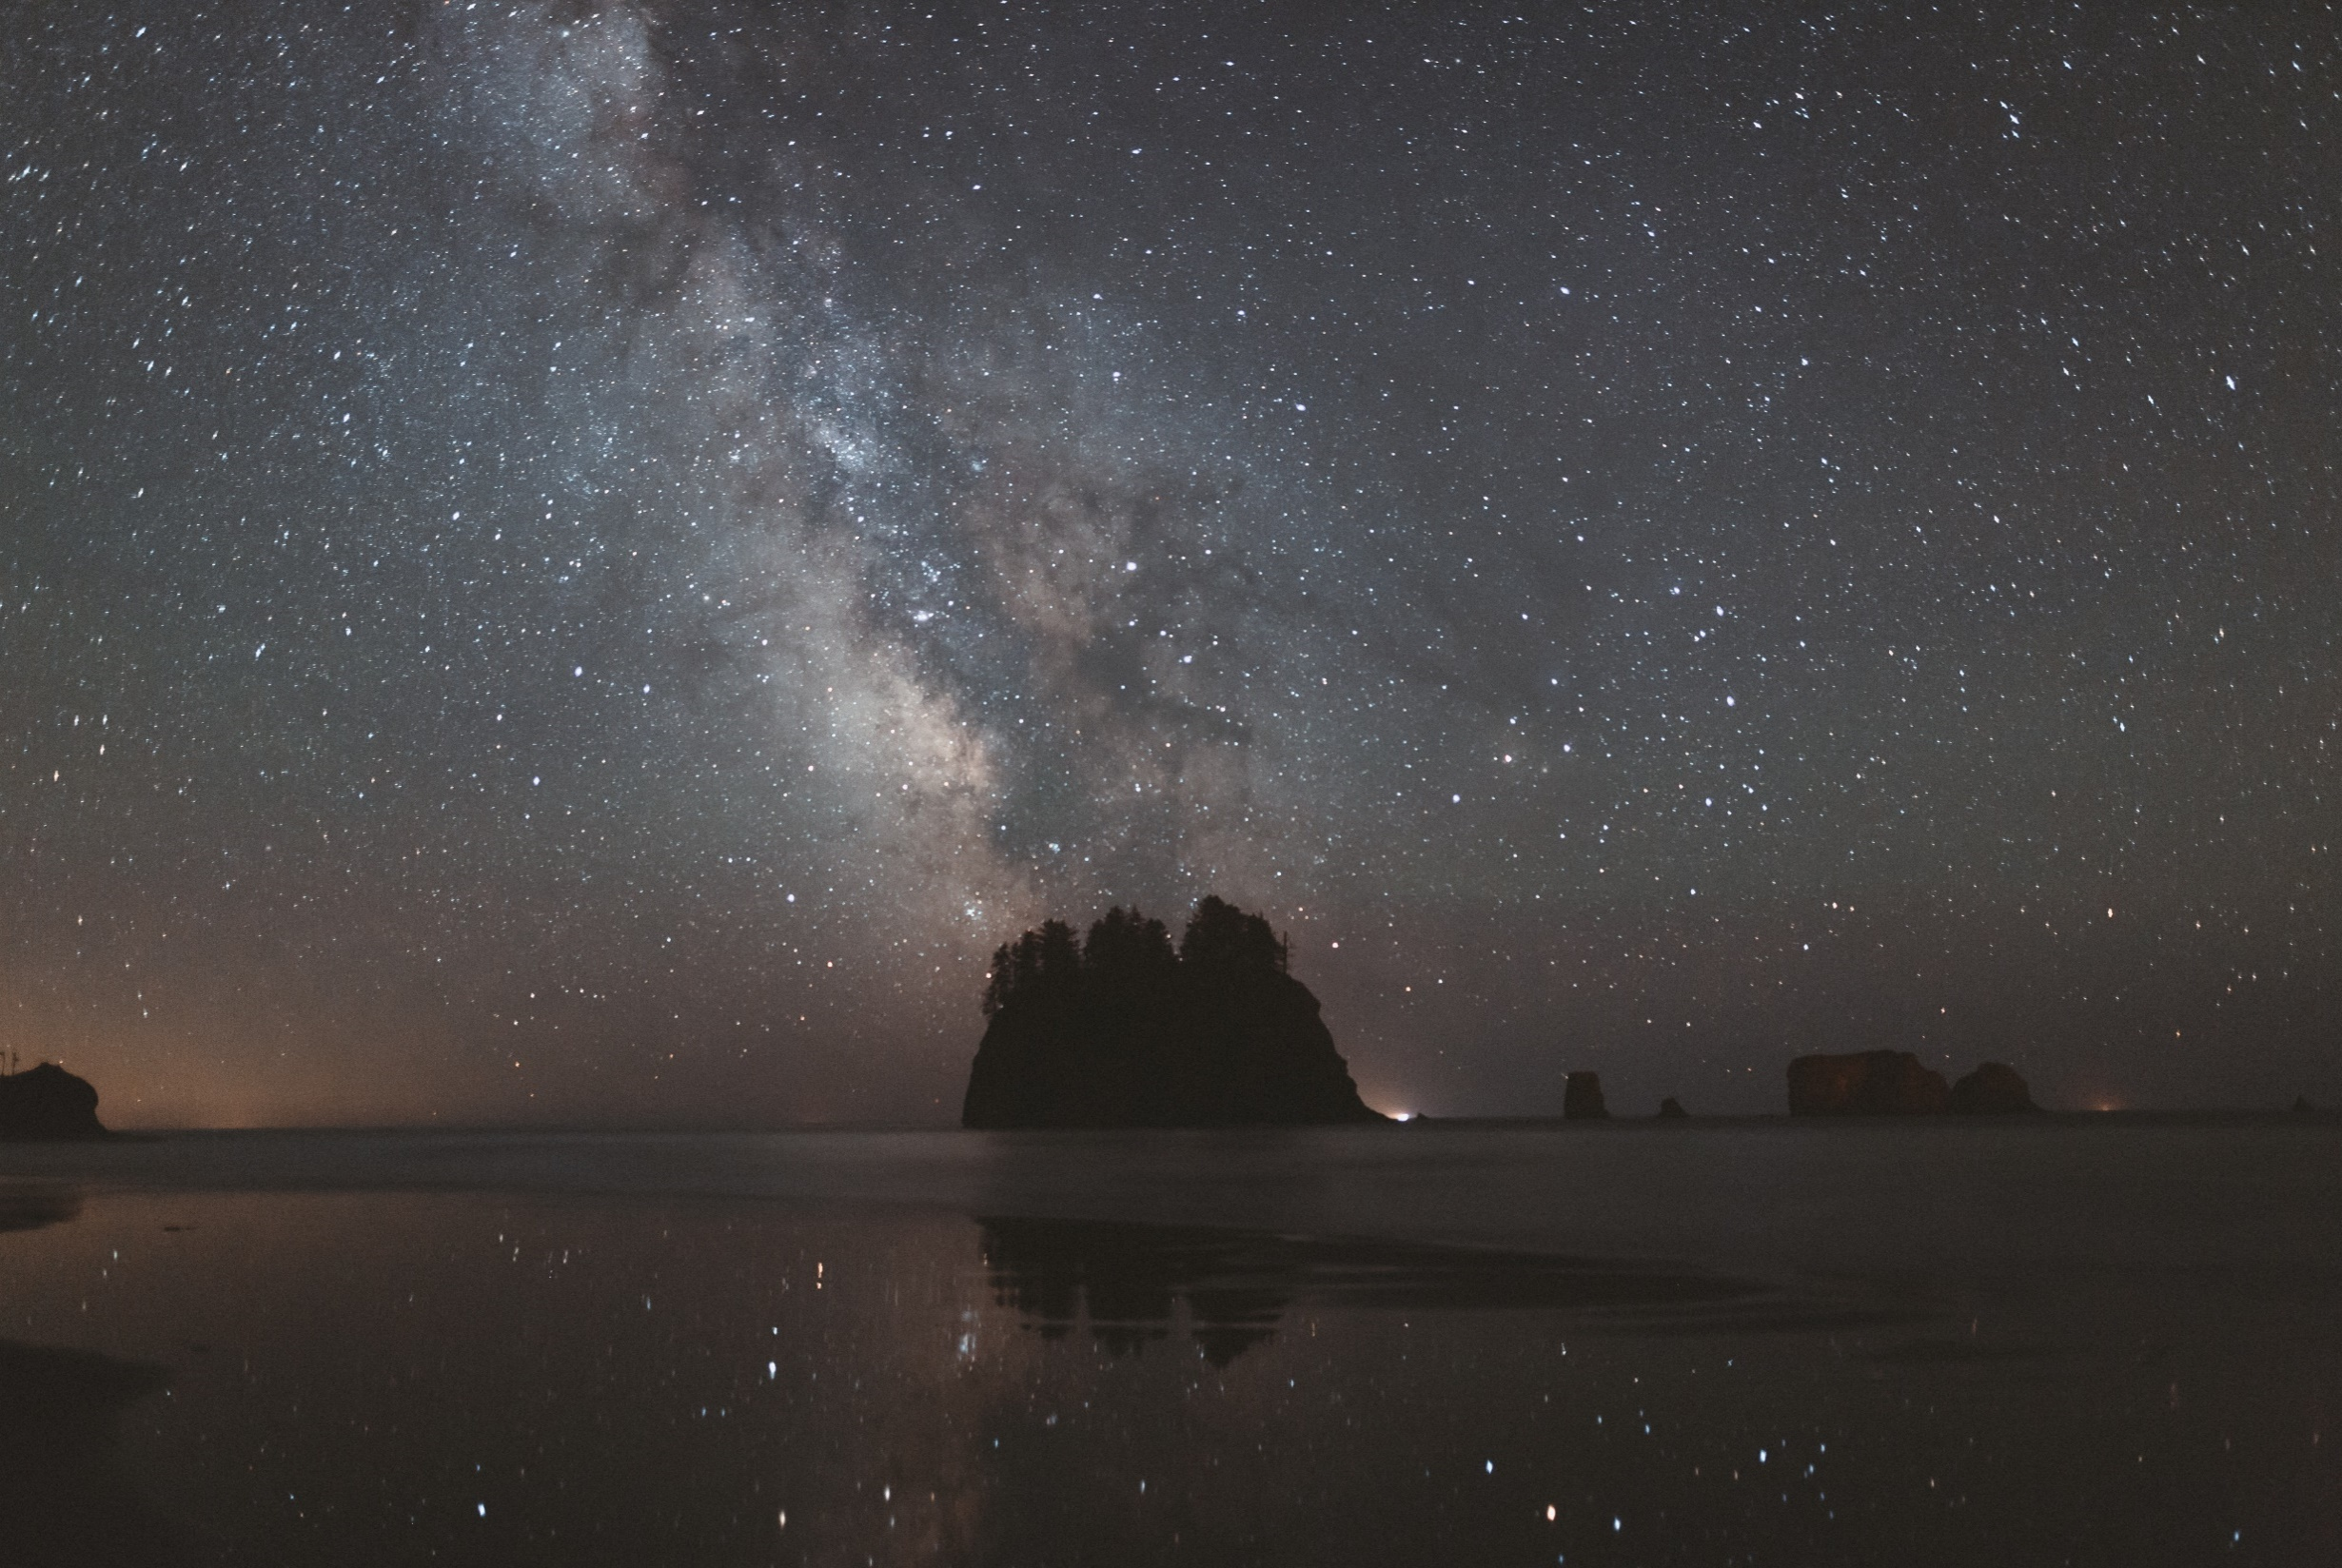
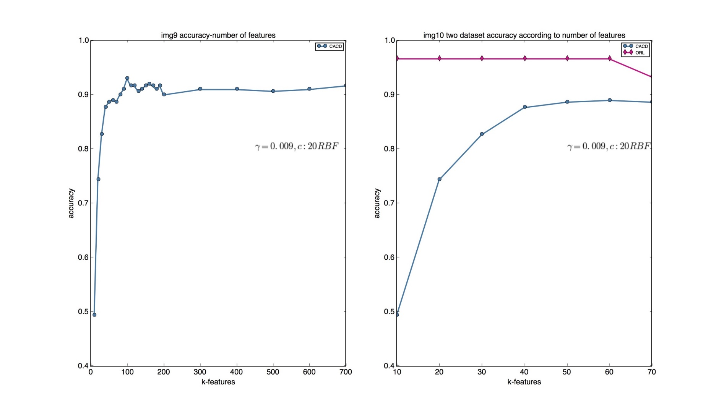

3PART
Accuracy-number of Features
Accuracy according to features

Slide 11
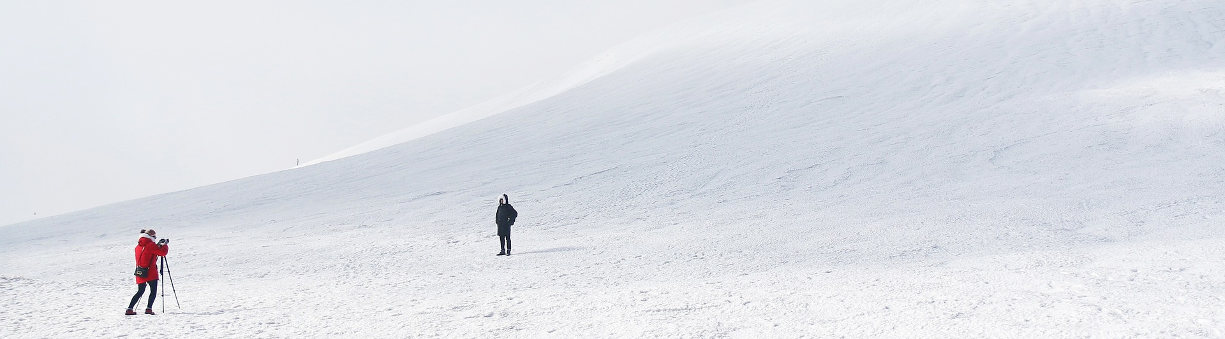
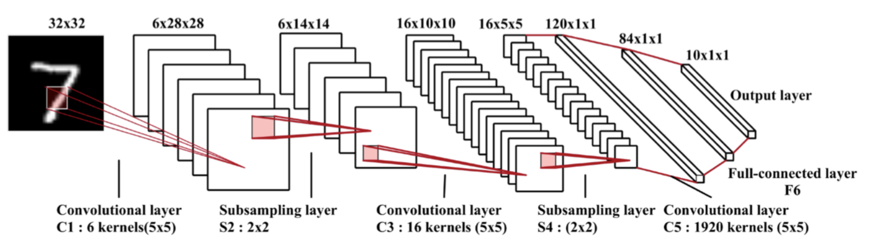
3PART
The CNN Algorithm
CNNs use a variation of multilayer perceptrons designed to require minimal preprocessing.
Based on their shared-weights architecture.

Slide 12
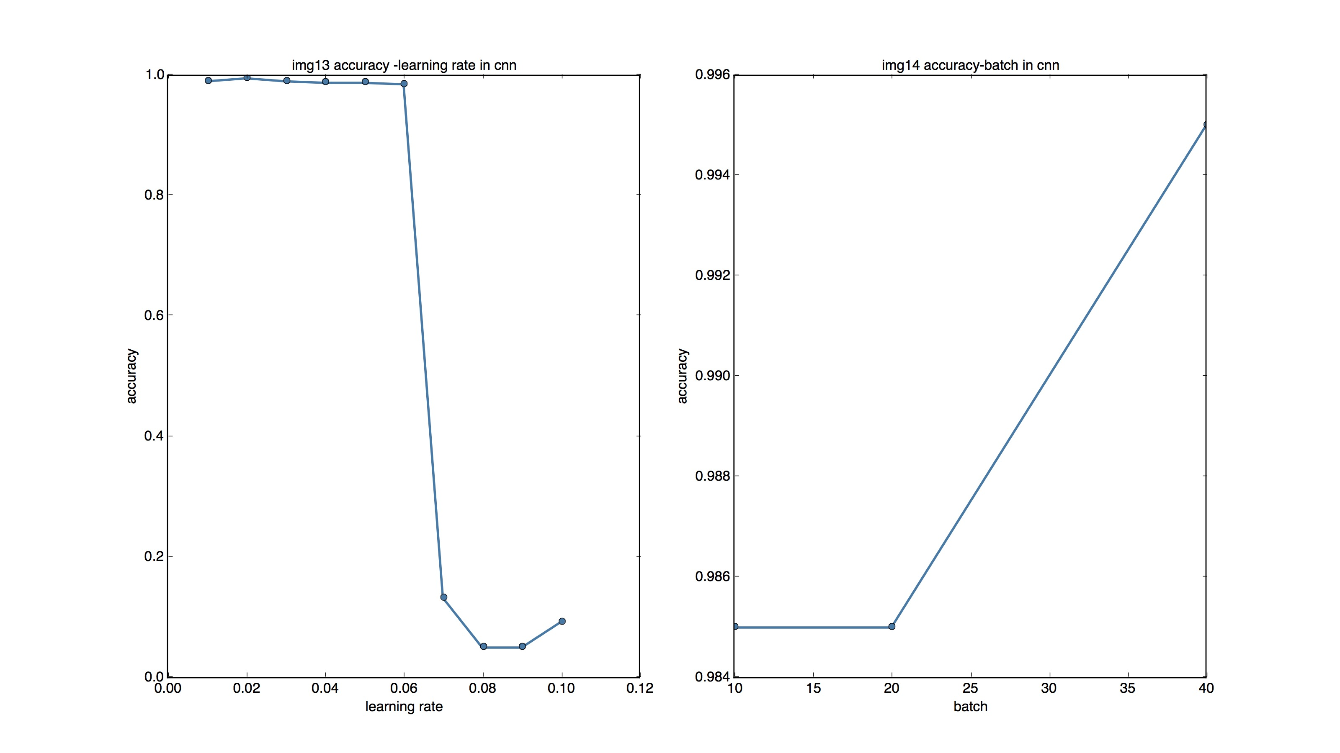
3PART
The Accuracy-Learning Rate in CNN and the Accuracy-Batch in CNN

Slide 13



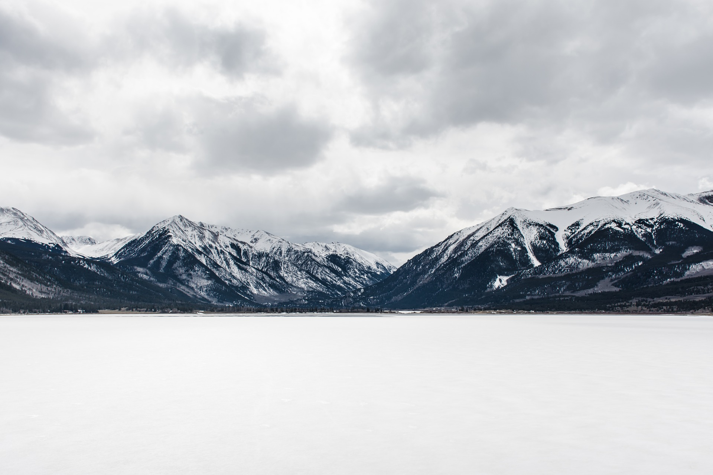
4PART
Conclusion
1
2
CNN performs better than other two algorithms.
it is possible for us to extract features that we have never noticed before.
3
KNN is a lazy learning method, it may take much time to recognize image if the dataset is very large
4
SVM need to spend some time in training model and is better when dealing with samples in high dimension,

Slide 14

THANKS

